Slide 1

FMF Bakery Selling Web App First Sprint Overview 31st January
Farha Islam Mim
Farnaz Jamilpanah
Micheal Blas Palpa

Slide 2
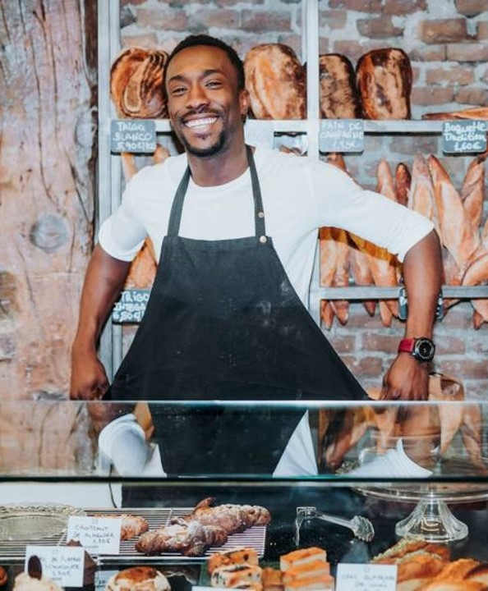
Introduction
The Bakery Selling Web App is designed to offer an easy, user-friendly platform for customers to browse, select, and order baked goods from a local bakery.
A dynamic catalog displaying various bakery products with detailed descriptions, images, and prices.
Allows customers to add items to their cart and review the order before checkout.
Customers can create and manage accounts, save favorites, and view order history

Slide 3
Target Users & Stakeholders
Customers – Need an easy way to browse, customize, and order bakery items online.
Bakery Owners – Require a platform to list products, manage orders, and receive payments.
Delivery Partners – Need a reliable system to receive and track delivery requests.
Developers & Designers – Responsible for building, maintaining, and improving the web app.

Slide 4

Main Functionality
User Authentication – Secure sign-up/sign-in for customers and bakery owners.
Product Management (CRUD) – Add, view, update, and delete bakery items.
Order & Customization – Customers can place and customize orders.
Payment & Tracking – Secure payments and real-time order tracking.
Seller Dashboard – Manage products, orders, and sales.
User Reviews – Customers can rate and review products.
Admin Panel – Manage users, orders, and content.
Promotions – Discounts, loyalty rewards, and special offers.

Slide 5

PROTOTYPE
Navigation Bar – Home, Products, Cart, Login/Signup.
Homepage – Featured products, categories.
Product Page – Images, descriptions, pricing, add-to-cart button.
Checkout Page – Payment options, order summary.
User Dashboard – Order history, profile settings (for logged-in users).
Seller Dashboard – Manage products, orders, and sales

Slide 6
User Stories for This Sprint
Customer: Sign up/log in to access and place orders.
Customer: Browse bakery products before purchasing.
Customer: Add items to the cart and complete orders.
Customer: Track order status for delivery updates.
Bakery Owner: Manage product listings (add/update/delete).
Bakery Owner: View and process customer orders.
Admin: Monitor users and orders for smooth operations.

Slide 7
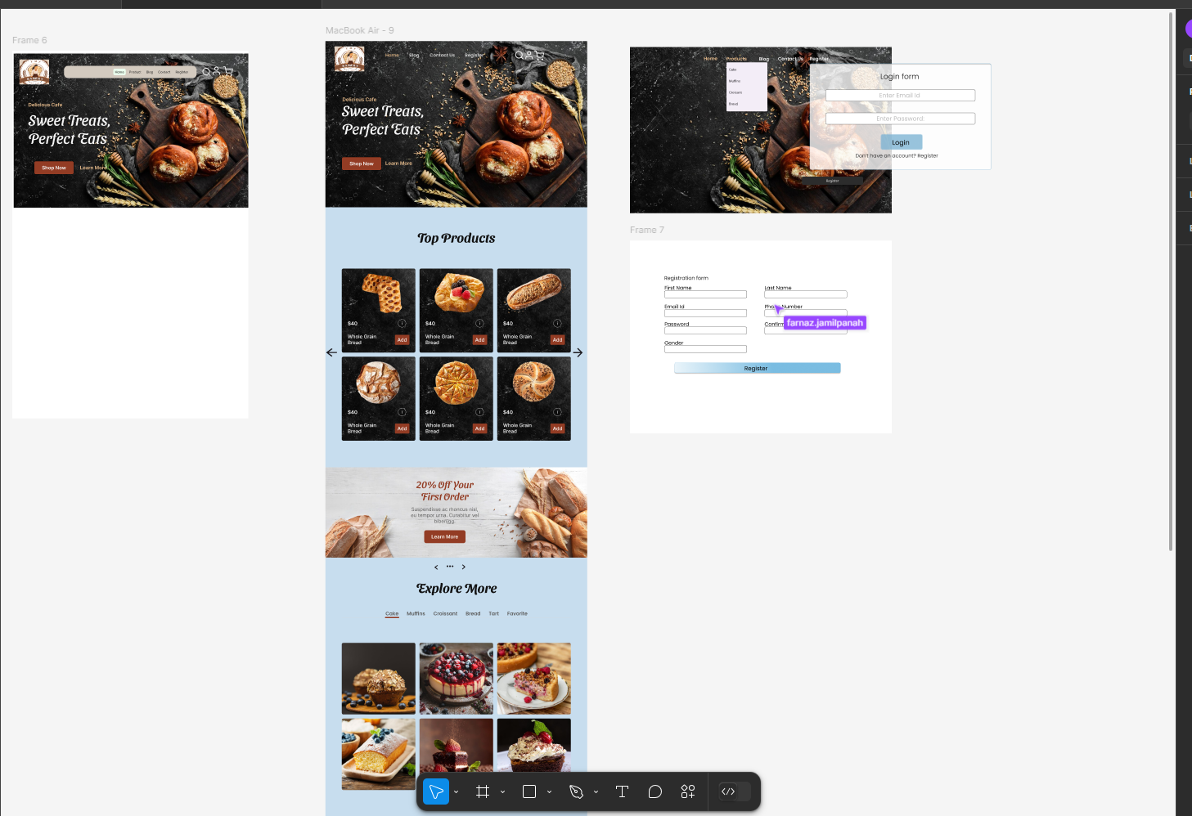

Slide 8
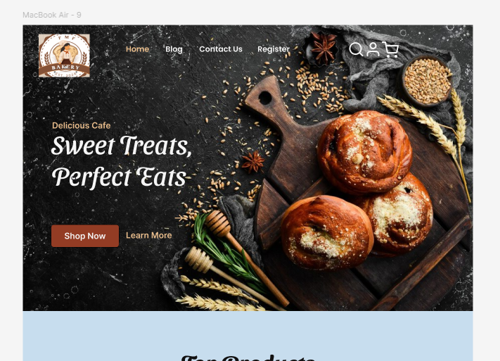
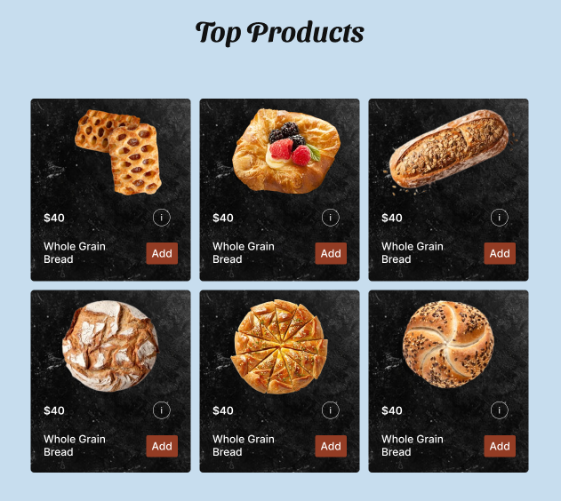

Slide 9
Product Backlog
Terllo

Slide 10
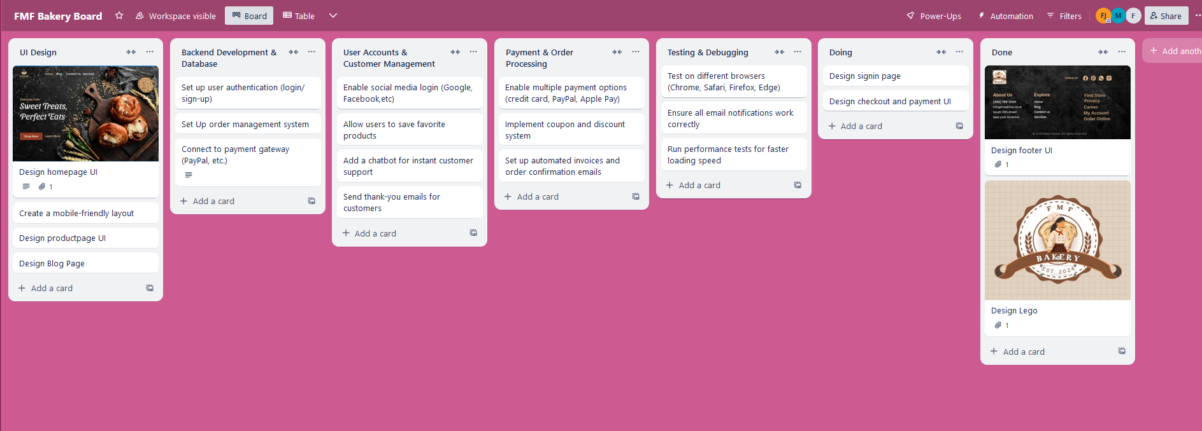

Slide 11

Daily Scrum
Quick check-ins helped track progress and align tasks.
Challenge: Some delays in UI design due to revisions.

Slide 12
Collaboration Highlight
The team worked well in synchronizing UI design and functionality, with quick feedback loops.
Effective communication among team members helped address blockers promptly and keep development on track.

Slide 13
Sprint Retrospective
Areas for improvement: Better time management for prototyping.
Future action points: Optimize UI/UX

Slide 14
Closing Remarks
Questions
Do we need to prioritize any specific features for the next sprint?
Next Steps
Focus on refining the UI/UX for smoother navigation.
Plan user testing for the next sprint to gather feedback and improve usability.

Slide 15
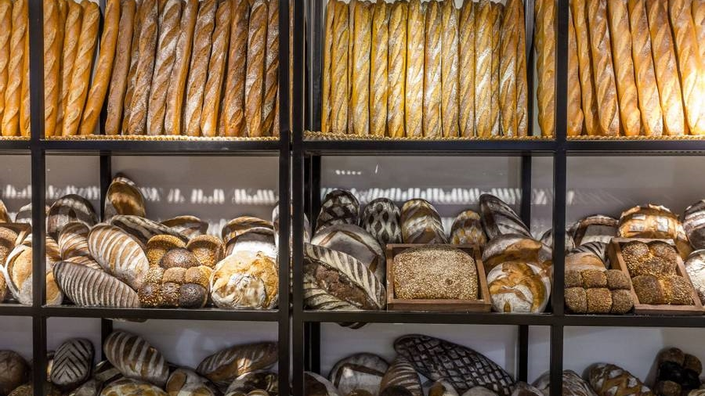
Thank you
15

